Slide 1
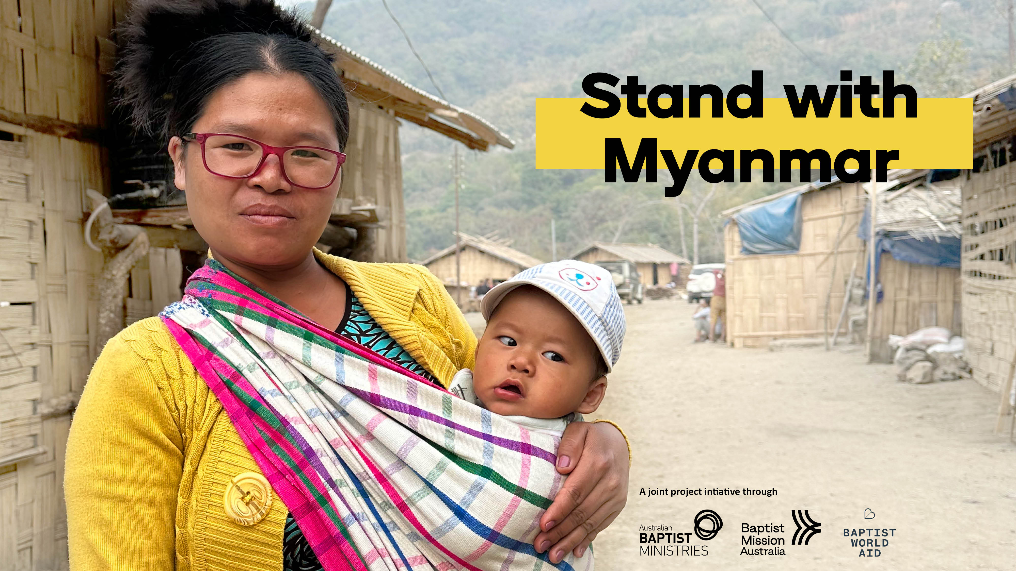


Slide 2
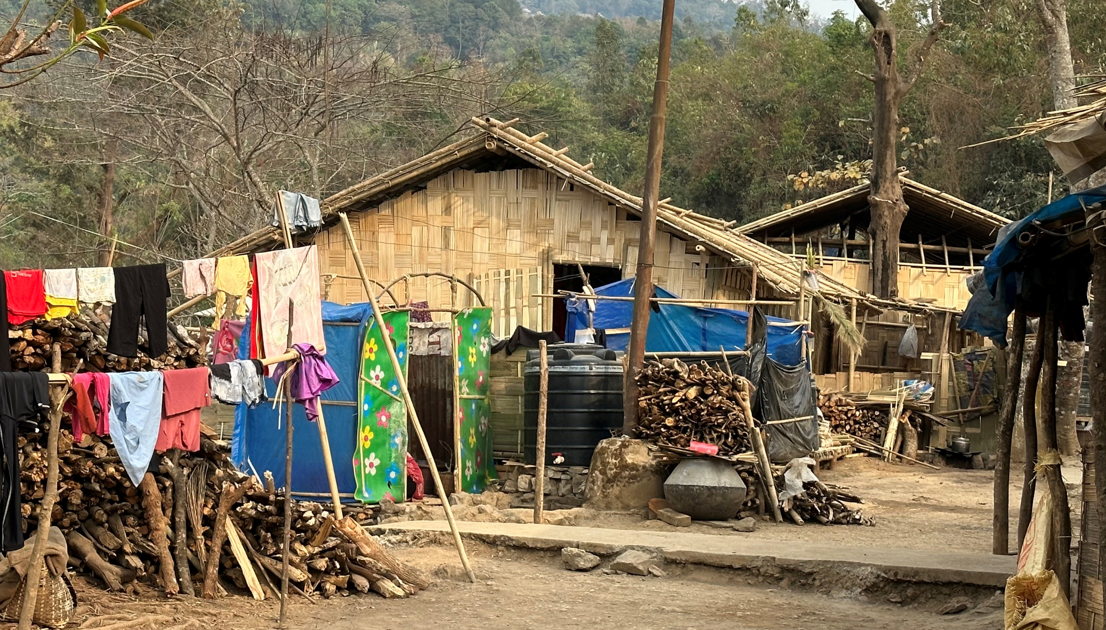

Background
Today is about joining together nationally, as Australian Baptists, to advocate for, pray for, and raise funds for our brothers and sisters of Myanmar (previously Burma)
In February 2021 there was a military coup and the nation has been under attack ever since.

Slide 3
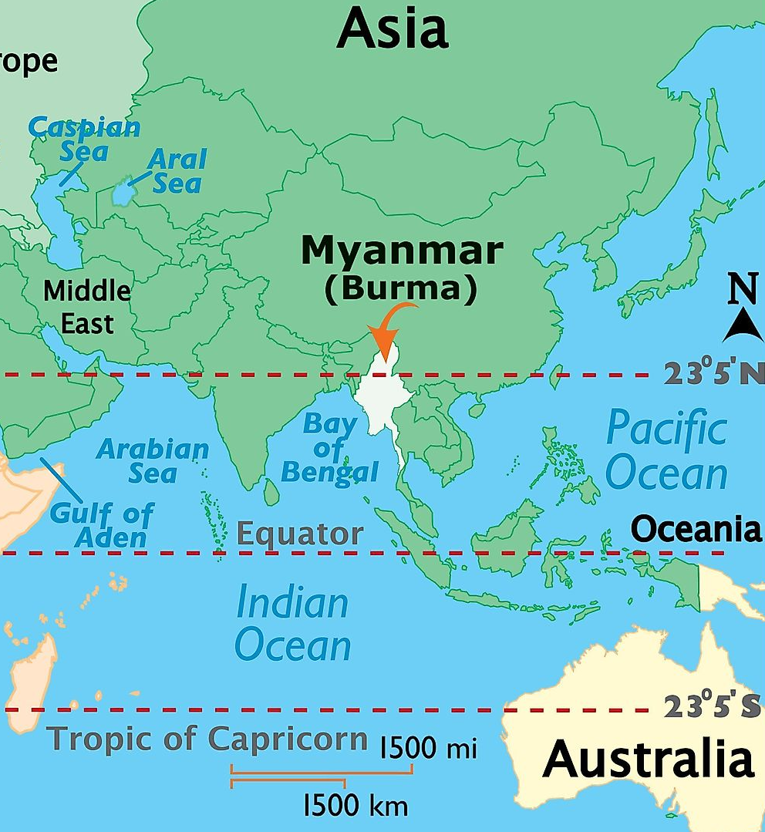
Where is Myanmar?
Myanmar (formerly Burma) occupies an area of 676,578 sq.km in the northwestern most part of mainland Southeast Asia.
One of the largest nations in this region, Myanmar borders the five other nations of India, Bangaldesh, China, Thailand, and Laos.

Slide 4
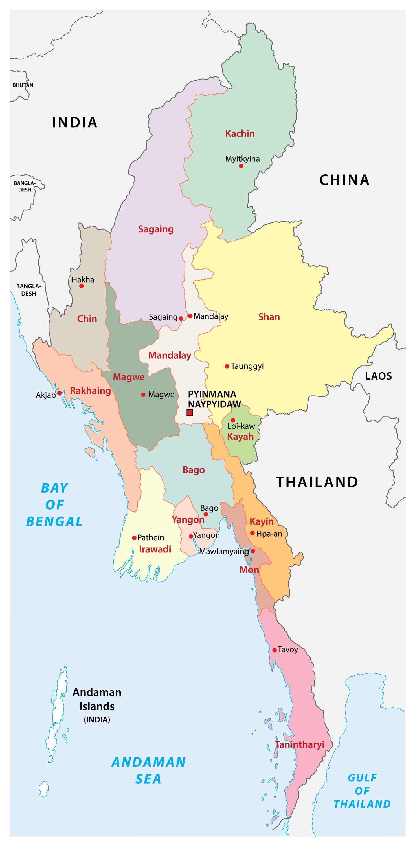
Myanmar Population - 54 million
– more than double Australia (26m)
– land size - 9% of Australia
Myanmar's geography is mostly made up of thick tropical rainforests, tall mountains, and surging river valleys.
Country divided into states

Slide 5
Since the military coup in February 2021
Whole cities have been burnt to the ground by the military junta and thousands killed by daily airstrikes
Thousands have lost their homes and are internally displaced, hiding in the jungle from the ongoing military attack
In ethnic areas, drone attacks continue to this day
Churches and schools are being bombed daily – continual casualties/deaths

Slide 6
Since the military coup in February 2021
In addition:
The military junta has introduced conscription
In Feb 2025, Myanmar experienced a devastating earthquake,
And recently US AID has been removed from border camps

Slide 7
Myanmar Baptists 2021
Prior to the war, Baptist church in Myanmar was the fastest growing church in the world with 1.7million Baptists.
Many ethnic tribes in Myanmar are Baptist
Here in Australia, we have a large Baptist population from Myanmar
Let’s come together to
Stand with the people of Myanmar

Slide 8
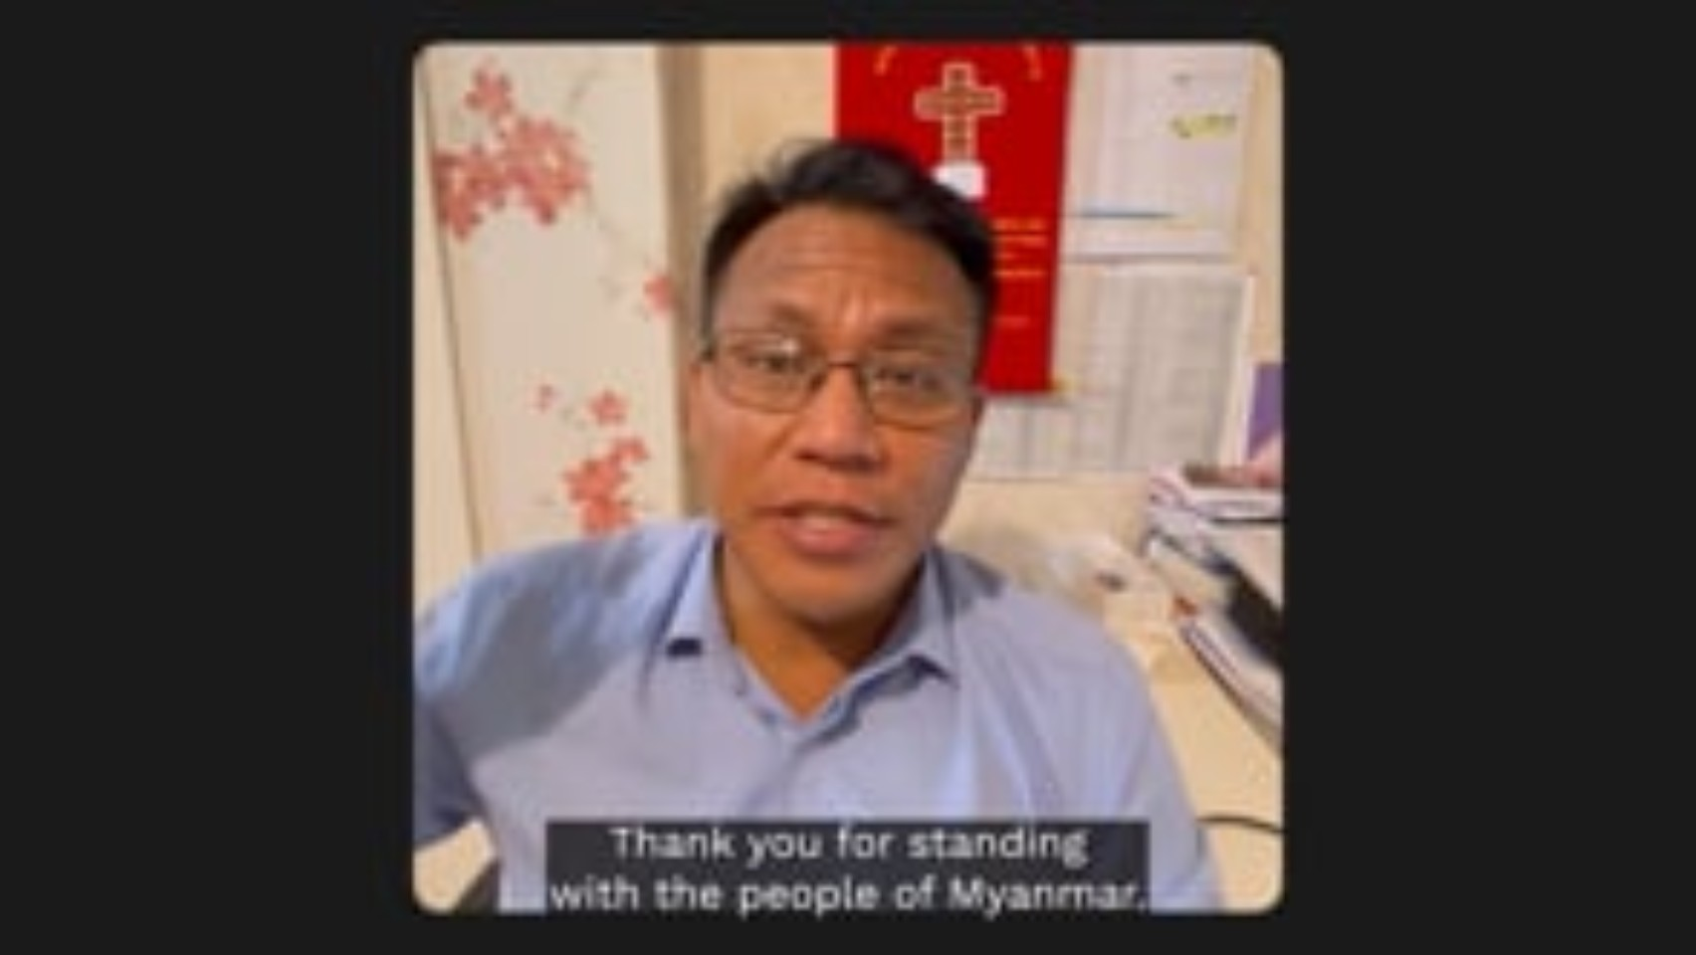

Slide 9
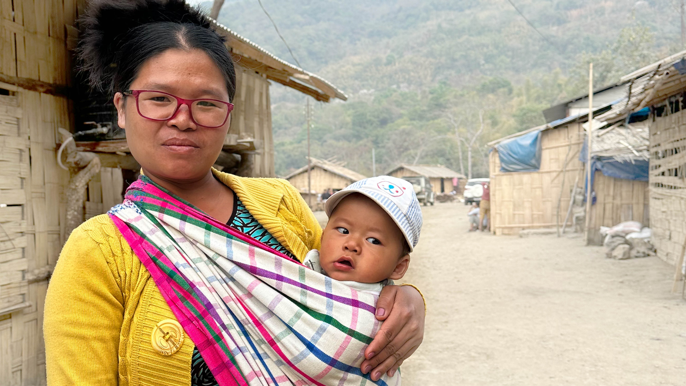
How can you help?

Slide 10
3 WAYS TO HELP
Act
Pray
Give

Slide 11
ACT
Write to your MP to express your concerns
Sign a pre-written letter (customisable) to your local Member of Parliament
Or write your own letter
(Template and document with tips for writing to your MP available)

Slide 12
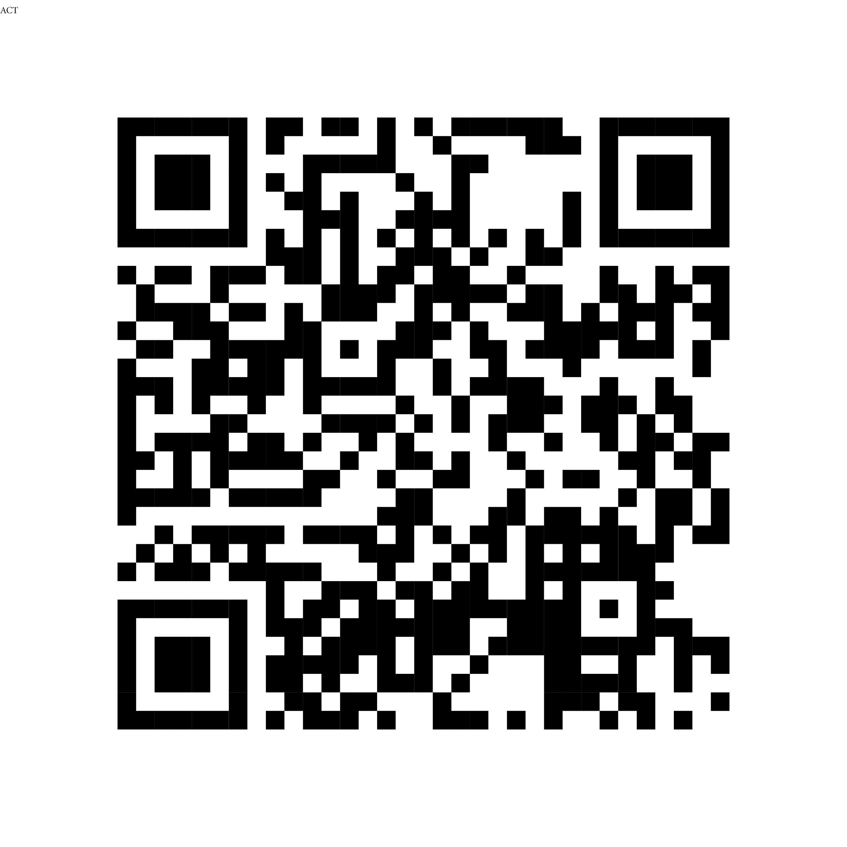
Amplify the message by adding your voice
Scan the QR code
Sign the pre-written letter to your local MP

Slide 13
Play video or have someone read responsive prayer

Slide 14
PRAY
Leader: We remember those who have lost their homes, their communities and beloved family members
ALL: Lord bring your peace and comfort to the people and places of Myanmar

Slide 15
Leader: Creator God, maker and sustainer or mercy and hope. We come before you today to pray for the people of Myanmar. Today so many are suffering through war, violence, disaster and persecution.
ALL: Lord, Protect your people and the places they call home.
PRAY

Slide 16
Leader: We grieve with those hurt by the earthquake earlier this year and with displaced families struggling with loss after recent floods.
ALL: Lord, bring comfort and healing.
PRAY

Slide 17
Leader: We pray for those who have been displaced by the war, living as refugees, on the move or in hiding. We especially remember families separated from one another.
ALL: Lord, provide safety and hope for the displaced. By your spirit, inspire advocacy, support and welcome in other countries and especially in our own.
PRAY

Slide 18
Leader: We pray for the Burmese Baptist family around the world and here in Australia. May your diverse church shine as a light, a place of fellowship and mutuality
ALL: Lord, strengthen your church in unity and self-giving love.
PRAY

Slide 19
Leader: God of justice, we long for the day when the people of Myanmar can live without fear and when peace, freedom and flourishing wil come to that land,
ALL: Lord, may your reign come, may your will be done in Myanmar.
PRAY

Slide 20
Leader: We entrust this prayer to you, God of compassion, maker and sustainer of mercy and hope. We pray together in the name of Jesus Christ, who suffers with the oppressed and reminds us that peacemakers are the children of God.
ALL: Amen.
PRAY

Slide 21
GIVE
Your generous financial support will make a tangible difference for vulnerable people in and around Myanmar
Tax deductible gifts will go towards vital humanitarian support such as: support for children and schools, and income generating skills training.
Non-tax deductible gifts will go towards faith-based support initiatives including: trauma training for pastors, leadership training and church planting.

Slide 22
GIVE
Gifts will be distributed through the partners of
Baptist World Aid and Baptist Mission Australia working on the ground in Myanmar.
No administration fees are being taken by any organisations involved which means 100% of the funds will be distributed within Myanmar.

Slide 23
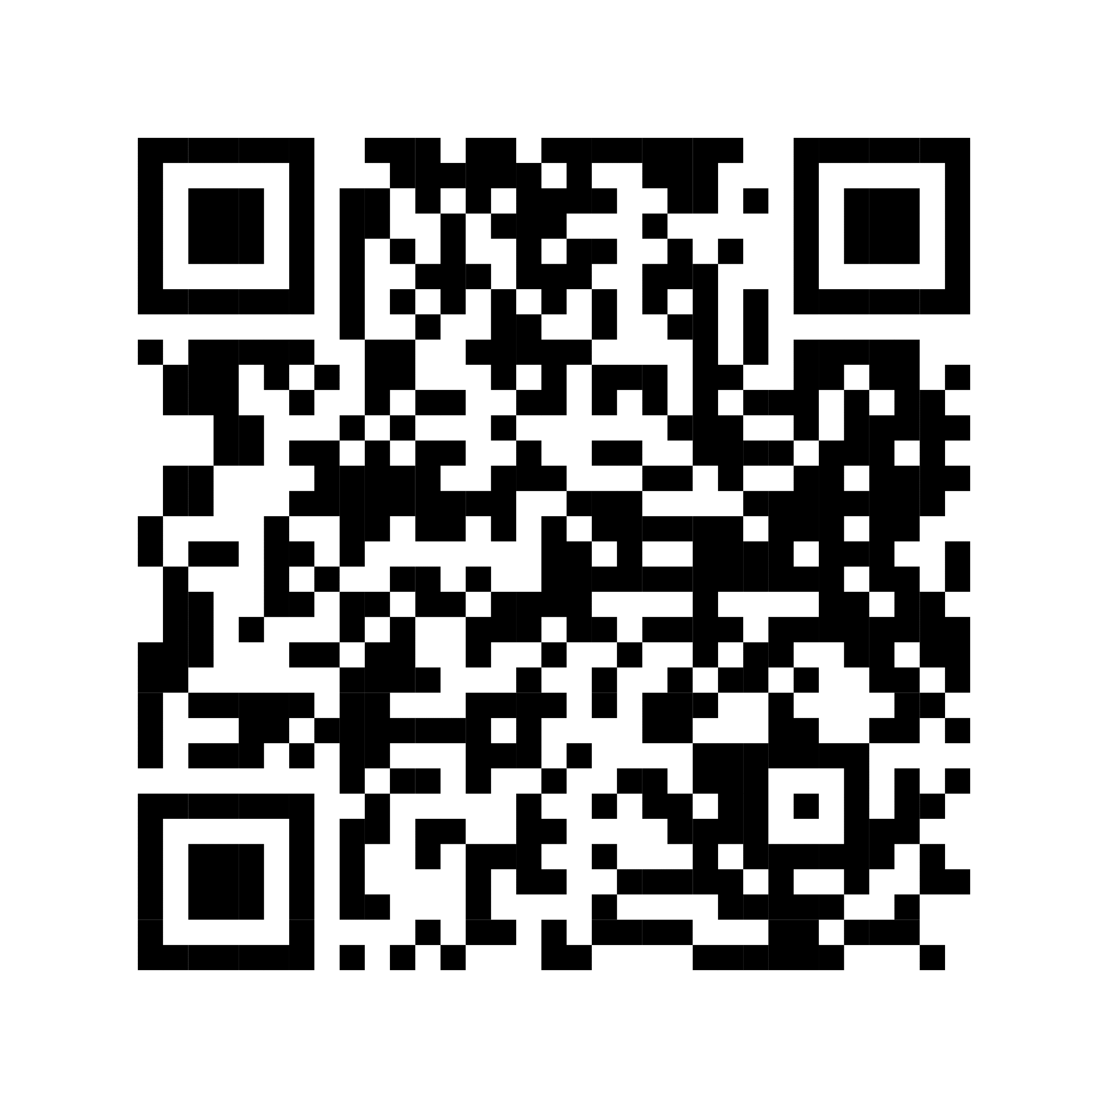
How to give?
GIVE
Give
through your church special offering
By scanning the QR code to the right
Use the giving card / slip to give at home

Slide 24
GIVE to provide
Thank you for joining with Baptists
around Australia to
Stand with Myanmar

